Slide 1
Program Transfer Group
JMP
CALL
INT

Slide 2
Jump Instruction
Conditional Jump
Unconditional Jump
JMP

Slide 3
Unconditional Jump
JMP instruction of 8086 :
IP
1000
JMP address (5000)
Initially IP pointed to the memory location 1000 (before jump instruction)
IP
5000
---------
After execution of jump instruction IP pointed to the memory location 5000 which is new address

Slide 4
JMP
Syntax : JMP addr
0000
IP
1000
JMP 5000
This is all about Theory part
PC = 5000
IP
5000
---------
FFFF

Slide 5
Practically :
Assembler will substitute this address.
Note:
JMP DOWN (label)
As a programmer we don’t know the physical address, because we are not writing program in memory, so assembler will responsible to convert symbols or labels into a physical address.
DOWN

Slide 6
JMP– Jump to specified address:
This instruction will cause the 8086 to fetch its next instruction from the location specified in the instruction rather than from next location after JMP instruction.
There are two basic types of JMP, Near and Far
Mnemonic: JMP address
Operation :
Jump to specified address
Flags :
No Flags are affected
Example: JMP

Slide 7
00000
Memory
Near JMP and Far JMP further described as direct and indirect. If the destination address is specified within instruction it is called as direct and if the destination address is in register or memory location
CS
IP
NEAR JMP
Ss
SP
DS
SI
Extra
DI
FAR JMP
CS
IP
NEAR JMP | FAR JMP
Destination location is in the same segment. | Destination location is in the different segment.
When NEAR JMP only IP changed and CS will remains same. | When Far JMP then both IP and CS changed.
Less stack memory is required | More stack memory is required
It is also called as an INTRA segment JMP | It is also called as an INTER segment JMP
FFFFF

Slide 8
Conditional Jump :
Conditional transfer instructions are also called as conditional jumps instructions.
There are total 18 conditional jump instruction as per given in the table.
For conditional jump instructions, if condition is true then only control is transferred to the target specified in the instruction.
if condition is false then control is transferred to the instruction that follows the conditional JMP.
Initially IP pointed to the memory location 1000 (before jump instruction)
IP
1000
Conditional JMP DOWN
1002
Next Instruction
If condition = False
If condition = true
After execution of jump instruction IP pointed to the memory location 5000 which is new address
IP
DOWN
5000
---------

Slide 9
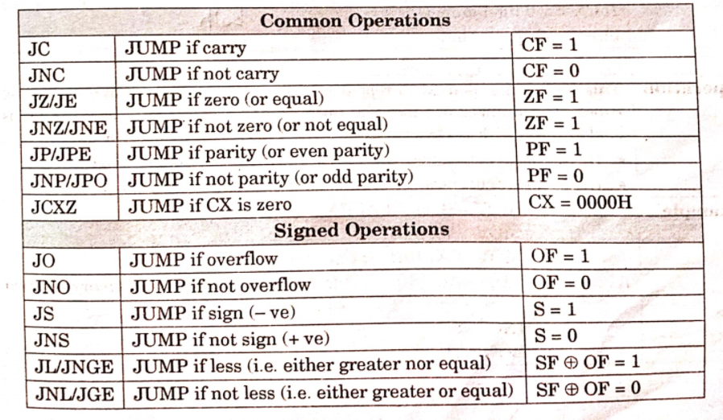

Slide 10
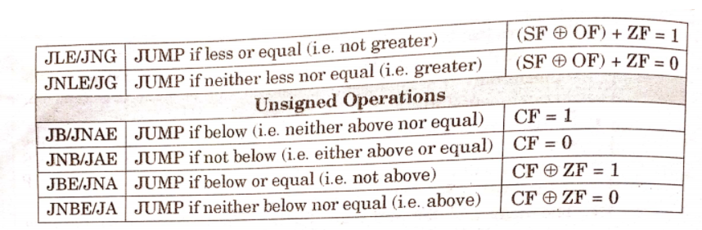

Slide 11
U | U | U | U | OF | DF | IF | TF | SF | ZF | U | AF | U | PF | U | CF
 | Mov al , 00h | AL= 00
 | Mov bl, 01h | BL = 01
 | Mov cl, 05h | CL = 05
BACK : | Add al , bl | AL= 00+01 = 01
 | Dec CL | CL=05-01=04
 | Jnz BACK | ZF=0,non zero Condition is true then jump to Back
 | End
0
jump to Back
U | U | U | U | OF | DF | IF | TF | SF | ZF | U | AF | U | PF | U | CF
1
Execute next instruction

Slide 12
CALL
Stack
Syntax : JMP addr
1002
PUSH
0000
IP
1000
CALL 5000
This is all about Theory part
PC = 5000
POP
IP
5000
---------
FFFF
RET

